Slide 1
World Builder
Arun Augustine
James Hall
Nithya Ningegowda
Kaushik Sivakumar
Matthew Stoltenberg

Slide 2
Introduction
CAD and architecture is difficult in 2D
Must translate 2D motion in to a 3D environment
Visualization
Requires expertise in software
World Builder solves these problems
Can move around an object to see it in 3D
Intuitive, easy to use interface

Slide 3
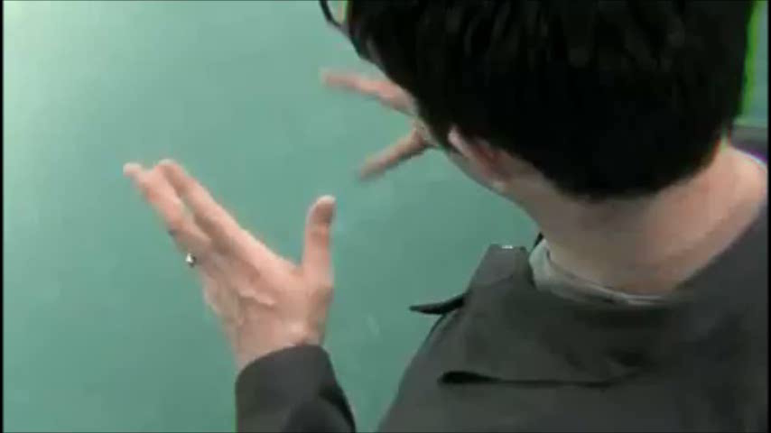
Motivation

Slide 4
Use Cases
Building Houses
Designing Cities
Designing Cars
Modeling Biological Structures (protein, DNA, cells, etc…)
Educational Geometry and Architecture

Slide 5
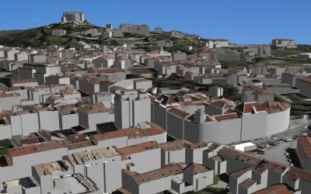
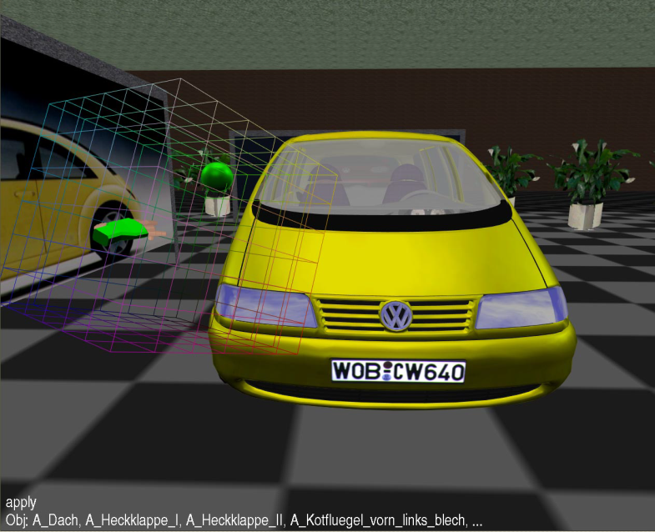
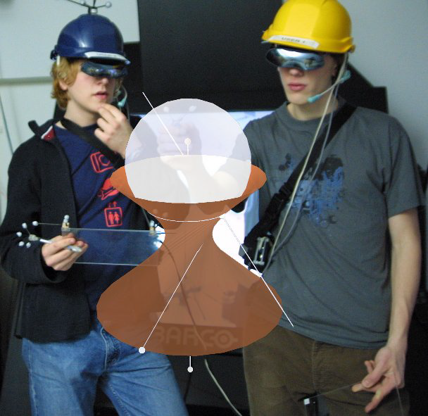
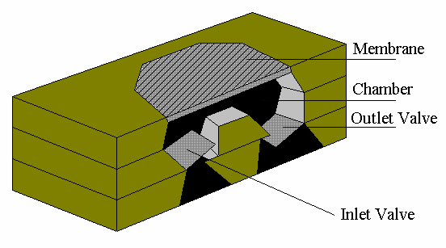

Slide 6
Design
Physical Environment
10’x30’ tracked area Vicon system
Head Mounted Display
2 6DOF Wiimotes with 11 buttons each

Slide 7
Design
Methods of interaction
Virtual Hand
Raycasting
PORT*
Creation/Deletion
Translation/Rotation/Scaling
Coloring/Texturing
Boolean Operations*
Union, Intersection, and Subtraction
Grouping Multiple Objects
Scale-the-World
Light and Sound**

Slide 8
Design
Actual Interaction
A button is used to select or grab an object, and to bring up the menu
Menus available
Object menu for creation
Materials Menu for coloring and texturing
Tools menu for deleting, grouping, and boolean operations
File menu for saving/loading* and exporting/importing*
Haptic Feedback**
Use the Wiimote’s rumble feature for user notification
i.e. Rumble when the user selects an object

Slide 10
Conclusions
Optional Work Items
Sound Creation and Manipulation
Light Creation and Manipulation
Haptic Feedback
Future Work
Simulation Effects
Gravity, wind, water, electrical, friction, collision detection

